Slide 1
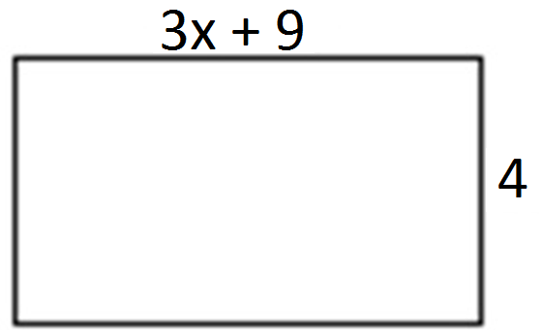
Name: ___________________________________
Topic 2:
Simplify the following expressions using the distributive property:
1.) 2x + 6(x + 5)
2.) 8(x – 9 + y) + 5x – y
3.) -(2 + 3x – y)
4.) 4(6x + 8) – 2(7x – 10)
Unit 3 Assessment REVIEW
Topic 1:
Write the following expressions without parenthesis using fewest terms possible:
1.) -4x – 3y + 9x + 18y 2) 6b + a – 3ab – 3a + 2b – 5b 3) 3(5x + 3) – 4(3x – 7)
4.) 9x – 2(x + 4) 5.) $\frac{1}{5}$(5x + 20) – $\frac{3}{4}$(8x – 12)
6.) What is the value of n when the expression
(-y + 8.3) + (3.2y – 9) is equivalent to 2.2y + n?
Topic 2: Writing Expressions
1.) Winnie wrote the following expression:
6a – 3b + 9a – 4a – 8b
a.) Simplify the expression.
b.) Write the simplified answer in factored form.
c.) Evaluate the expression when a = 4 and b= -3.
1.) Admission to a carnival costs $4. Each ride ticket costs $1.50. Create an expression that shows the total cost to go to the carnival if you buy t tickets?
2) Jackson deposits $120 into his account and then withdraws $20 each week. Write an expression for the amount in his account after w weeks.
a.) Write a simplified expression for the perimeter of the rectangle.
b.) Write a simplified expression for the area of rectangle.
5.) 0.4(2b + c) + 0.9c – 1.3b
Topic 3: Evaluating Expressions
1) Sophia pays a $17.99 membership fee for an online music store.
If Sophia purchases n songs for $0.99 each, write an expression for the total cost.
B. What is the total cost if Sophia buys 8 songs?
2) A landscaper charges $25 for each job plus an additional $15 for each hour worked.
a.) Write an expression to represent the total cost of a landscape job. Explain what the variable used in the expression represents.
b.) Evaluate how much he earned for a job that took him 5 hours.
3) What is the value of the expression below when n = 24 and p = -3?
$\frac{n}{3}−1+5p−2n+ p^{2}$

Slide 2
Topic 4:
Factoring
Factor the following problems (always finding the GCF). Circle your answers.
1.) 24a + 15 2.) 12c + 48d + 16 3.) -16x + 18xy - 10xyz
5) A rectangle has a width of 7 units. The area of the rectangle is 28x + 42 square units. What is the length of the rectangle?
4.) Which expressions are a factor of -60xyz – 24xy + 72xyz? Select ALL that apply.
2
4
24
12y
2xy
6xyz
xyz
6) The perimeter of a square is 4(x + 20). What does x + 20 represent?
7) Lucy mows five lawns. The total earned is 5(x + 15). What does x + 15 represent?
8) Jeremy works 5 hours per day. He charges an hourly fee and an additional $9. He uses the expression 25x + 45 to show how much he made over the course of five days, where x is the hourly rate. Write an equivalent expression that shows how much he makes per day.
Topic 5:
Spiral Review
1) Solve the following multiplication problems: a.) -3(8) b.) 3.2 ∙ -3.4 c.) - $\frac{2}{20} ∙ \frac{10}{11}$ 2) Solve the following division problems: a.) $\frac{−35}{−5}$- b.) 7.7 ÷ 0.9 c.) - $\frac{5}{12} ÷−\frac{20}{11}$
3.) Simplify each expression. a) 4(6x + 8) – 2(7x – 10) b) 0.4(2b + c) + 0.9c – 1.3b
4.) Write a – b as an addition expression:

