Slide 1
Hint:
There are four (an even number) of the variable x. They all must be positive or all negative.

Slide 2
Hint:
Write as improper fraction.
Hint:
Write as improper fraction.
Then…
KEEP CHANGE FLIP
Hint:
This says “a does NOT equal 0.”

Slide 4
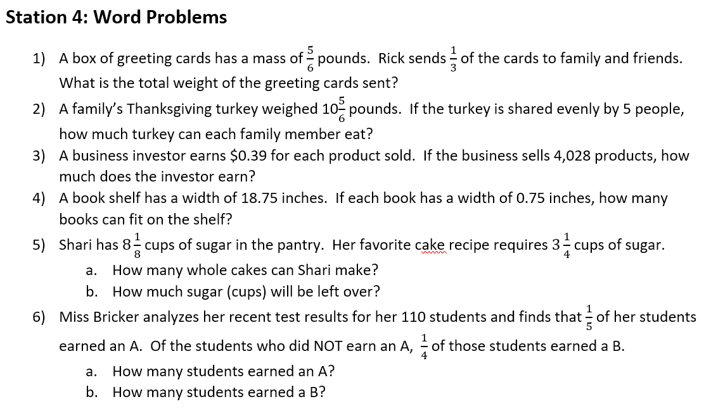
Hint:
“1/3 of the cards” means 1/3 times 5/6
Hint:
How many recipes of 3¼ fit in 8¹/₈?

Slide 5
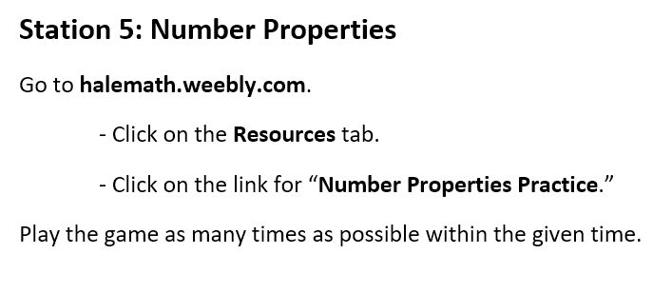
Hint:
After playing once, refresh the screen and try again for extra practice.

