Slide 1
Getting to Know Your Calculator
Hello!
(If you have a calculator in your locker, go get it.)

Slide 2
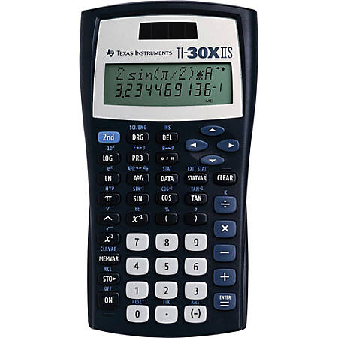
On/Off
Parenthesis
Ans

Slide 3
Negative Numbers
-9.72
-3.78 – 5.94
13.782 – (-21.983)
35.765

Slide 4
Fractions
1.5555555556
²/₃ + ⁸/₉
-1⁴/₅ + (-⁷/₈)
-2.675

Slide 5
Fractions (Answers as Fractions)
1.5555555556
1 ⁵/₉
²/₃ + ⁸/₉
-1⁴/₅ + (-⁷/₈)
-2.675
-2 ²⁷/₄₀

Slide 6
Fractions <->Decimals
⁹⁹/₂₀₀
0.45 + 0.045
-4.567 + 6.789
2 ¹¹¹/₅₀₀

Slide 7
Exponents
0.7569
0.87²
-1.74²
2.3⁴
(-1.98)⁷
-3.0276
27.9841
-119.3043645

Slide 8
Exponents
Round to the nearest hundredth if necessary.
0.7569
0.76
0.87²
-1.74²
2.3⁴
(-1.98)⁷
-3.0276
-3.03
27.9841
27.98
-119.3043645
-119.3

Slide 9
Solving Equations
Round to the nearest hundredth if necessary.
-7x + 9 = 82
2x – 13 + 21x = 54
x = -10.43
x = 2.91

Slide 10
Solving Equations
Round to the nearest hundredth if necessary.
-3(2x + 5) = 24
9 – 4(3x – 1) = 48
x = -6.5
x = -2.92

