Slide 1
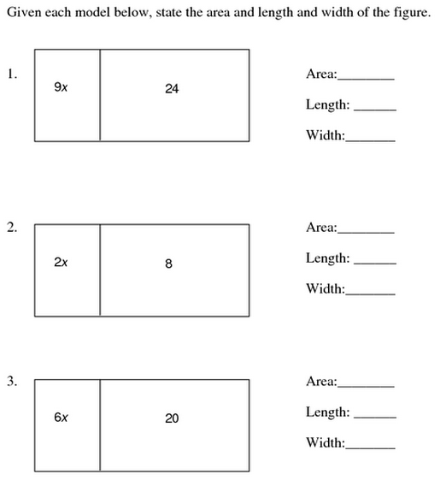
Station 1 (A)
Station 2 (A)
Factor. If the expression cannot be factored, write cannot be factored (CBF).
12x + 48 2. -6x – 16
13x + 9 4. 9xy – 3xyz + 27xyz
Factor. If the expression cannot be factored, write cannot be factored (CBF).
1. 5abc – 25a – 100ac 2. 18xyz – 6xy – 36xyz
Station 3 (A)
3. 2ab – 3a – 12abc 4. 4ab – 12a – 36a

Slide 2
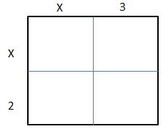
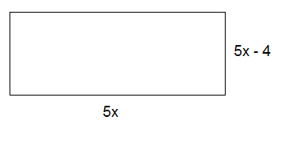
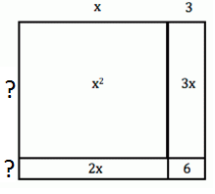
Station 4 (A)
Factor out the coefficient of the variable
1)
2)
3)
4)
Station 5 (A)
Factor out the coefficient of the variable
1) 1.5b – 9
2) -1.8k – 7.2
3) Bradley 7 hours per day. He charges an hourly fee and an additional $12. The expression for how much he earns over the course of 5 days can be written as 35h + 60, where h is the hourly rate. Write an equivalent expression that shows the amount he earned each day.
4) Jen works 8 hours per day. She charges an hourly fee and an additional $10. She uses the expression32x + 40 to show how much she made over the course of 4 days, where x = the hourly rate. Write an equivalent expression that shows how much she makes per day.
Station 6 (A)
Numbers 1-2: Find the area of the shapes. Write your answer in simplified form.
1.
2.
Numbers 3-4: Use the areas inside the shapes to find the missing lengths.
3.
4.
3x
-1
6x² | -2x
9x | -3
?
Factor out the GCF of each expression
?

Slide 3
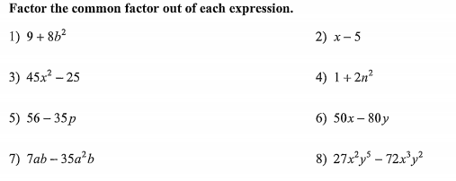
Station 7 (A)
Station 8 (A)
Station 9 (A)
1) Xander goes to the movies with his family. Each family member buys a ticket and two boxes of popcorn. If there are six members of his family, let 𝒕 represent the cost of a ticket and 𝒑 represent the cost of a box of popcorn. Write two different expressions that represent the total amount his family spent. *Hint: One can be a sum, and one can be the product of two factors.
2) At a store, a shirt was marked down in price by twelve dollars. Following this change, the price of every item in the store was cut in half. Write two different expressions that represent the new cost of the shirt, using 𝒔 for the original cost of each shirt.
Station 10 (A)
1) A new miniature golf and arcade opened up in town. For convenient ordering, a play package is available to purchase. It includes three rounds of golf and 15 arcade tokens, plus five dollars off. There is a group of four friends who are each purchasing this package. Let 𝒈 represent the cost of a round of golf and let 𝒕 represent the cost of a token. Write two different expressions that represent the total amount this group spent. *Hint: One can be a sum, and one can be the product of two factors.
2) Mrs. Jones decides to take her son, Wesley, and his friends to Chuck E. Cheese for his birthday. A birthday package is available to purchase. For each child, it includes four rides and 12 arcade tokens, plus three dollars off. There is a group of ten kids (including Wesley) attending the birthday party. Let r represent the cost of a ride and let 𝒕 represent the cost of a token. Write two different expressions that represent the total amount Mrs. Jones spent on the party.

