Slide 1
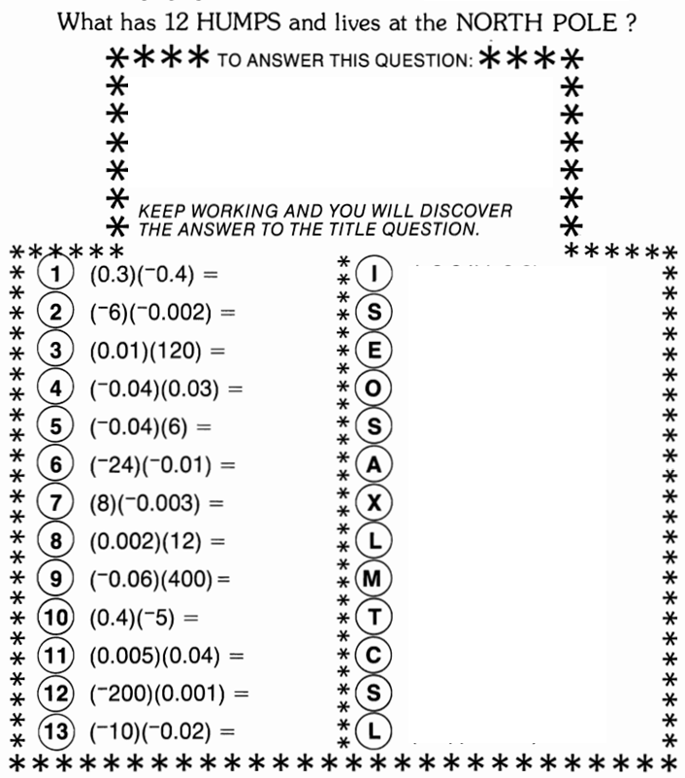
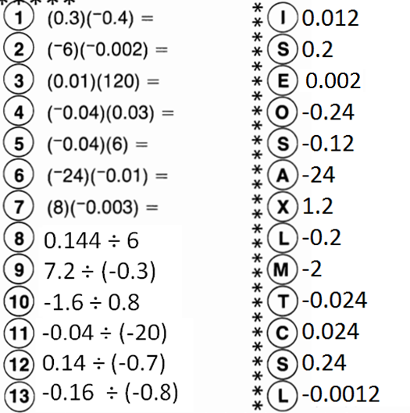
Multiplying and Dividing Decimals Name___________________________
Homework
Do the problems on the left on a SEPARATE piece of paper. Find the answer to the question on the left where the letters are on the right. Then solve the puzzle.

